Slide 1
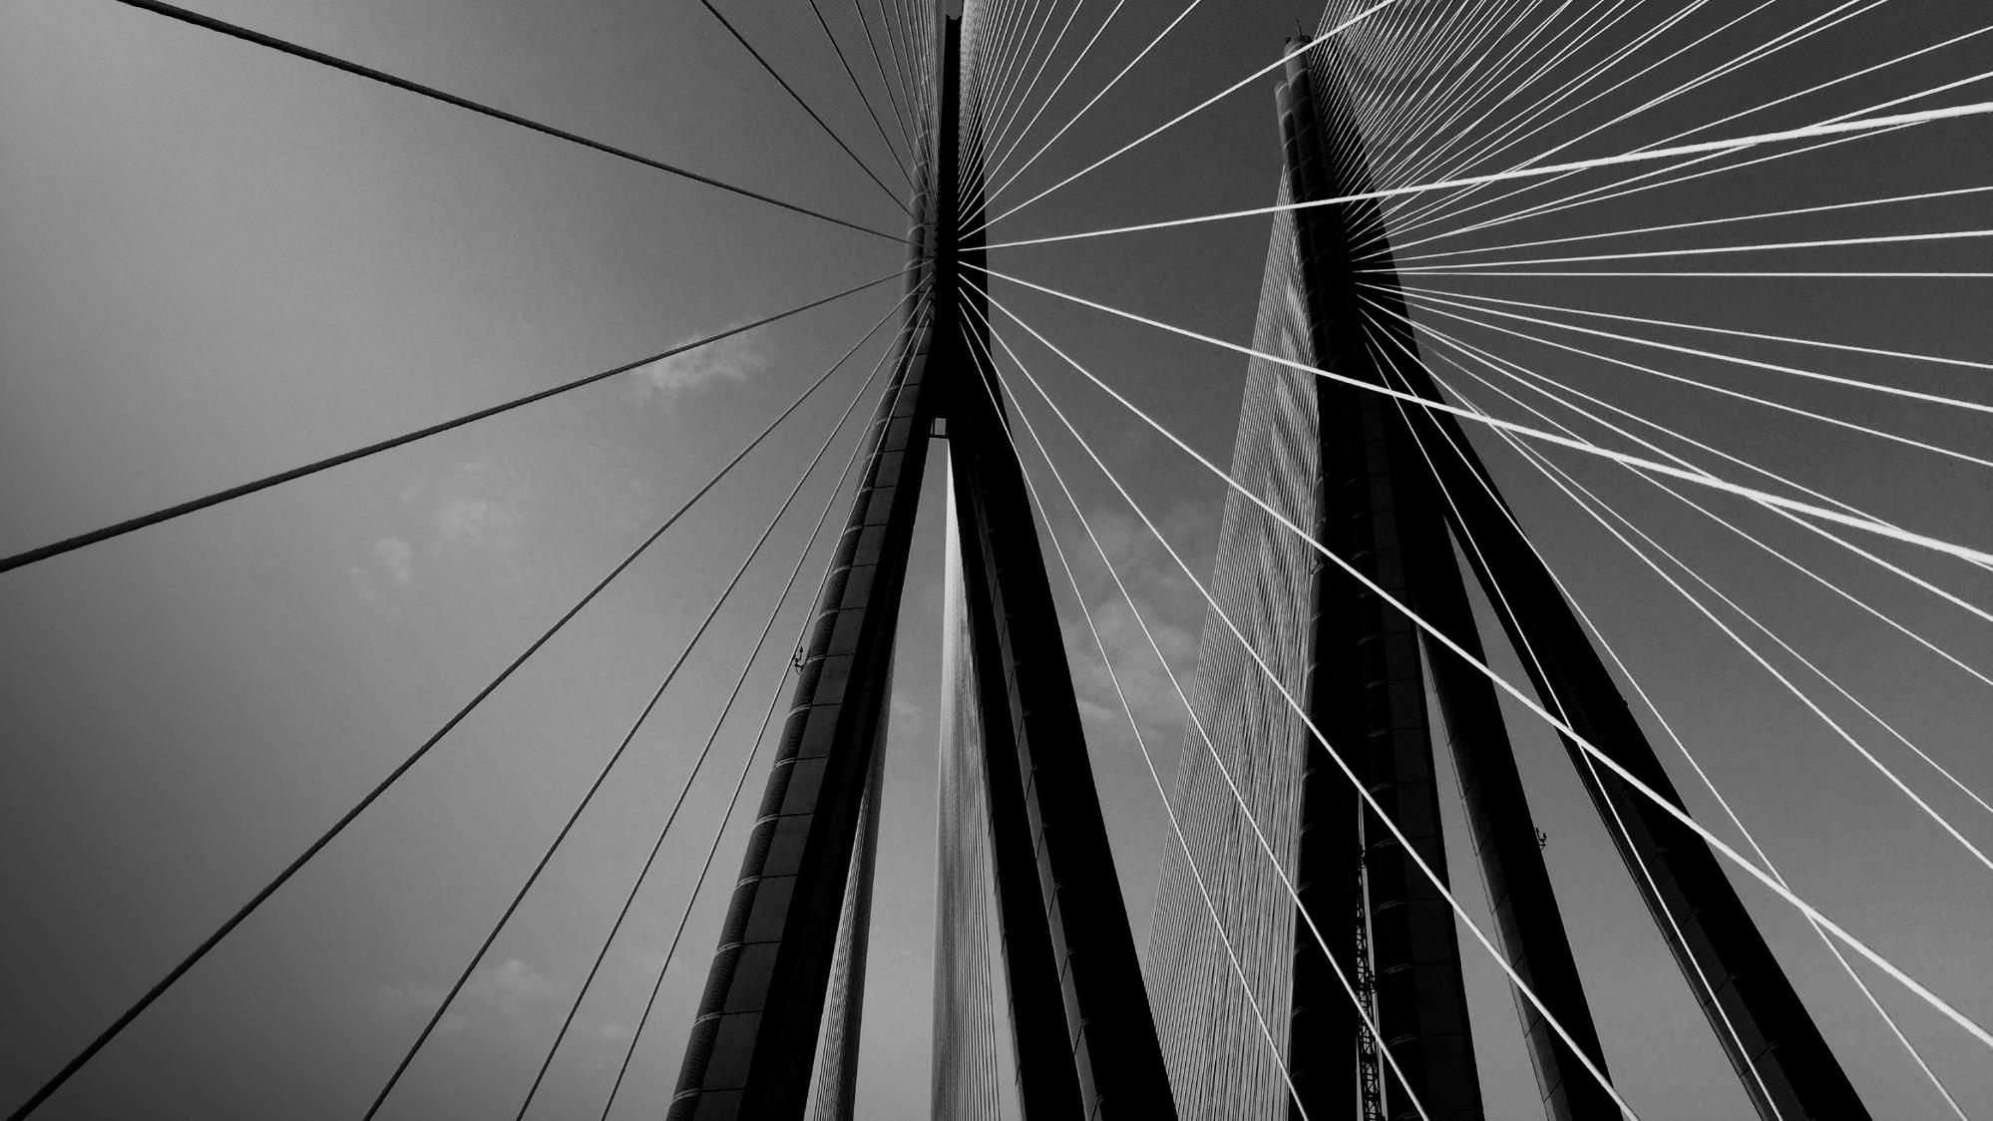

Presented by: Rashmi Dyapangoudra
Enhancing safety and hazard management in scrap-based liquid steel production

Slide 2


Sharat Manikonda
Director at Innodatatics and Sponsor
linkedin.com/in/sharat-chandra
Mentor:Bhavesh

Slide 3

Contents
Business objective
Business Constraints
Project Architecture
Data collection and details
Modeling
Evaluation
Deployment
Future scope

Slide 4
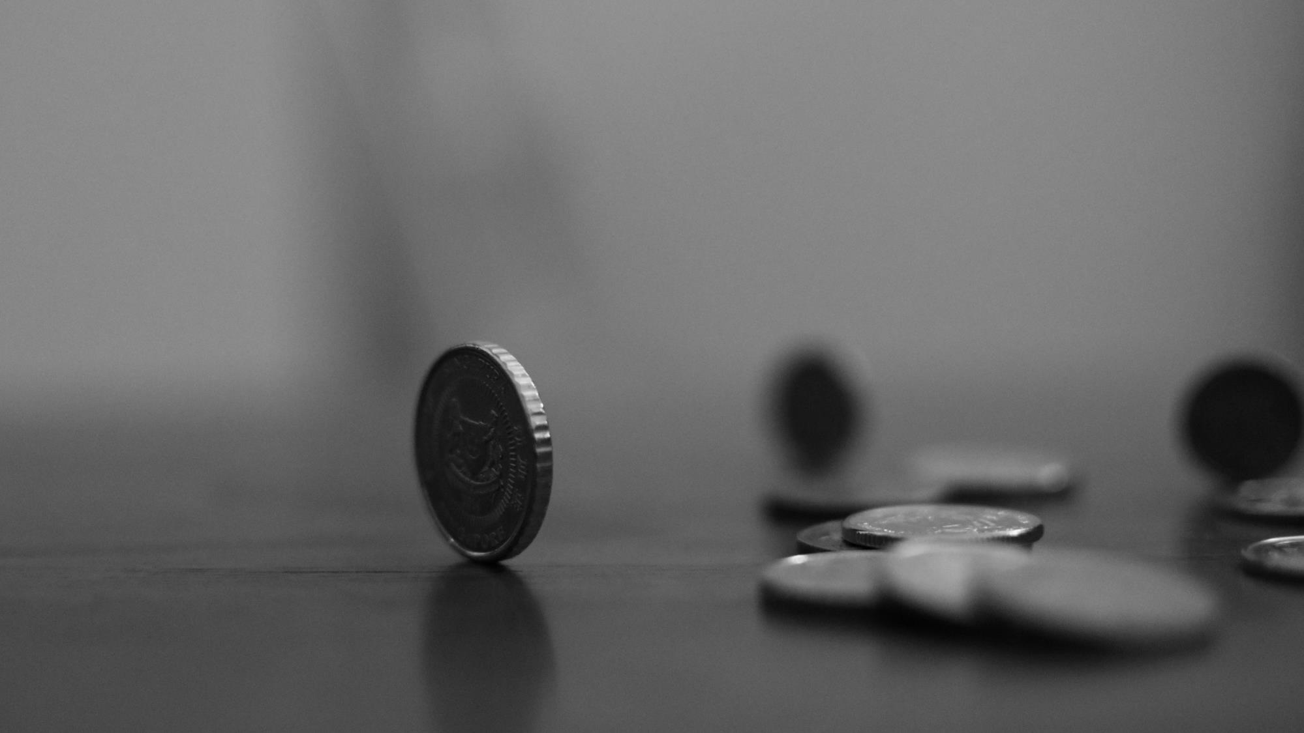
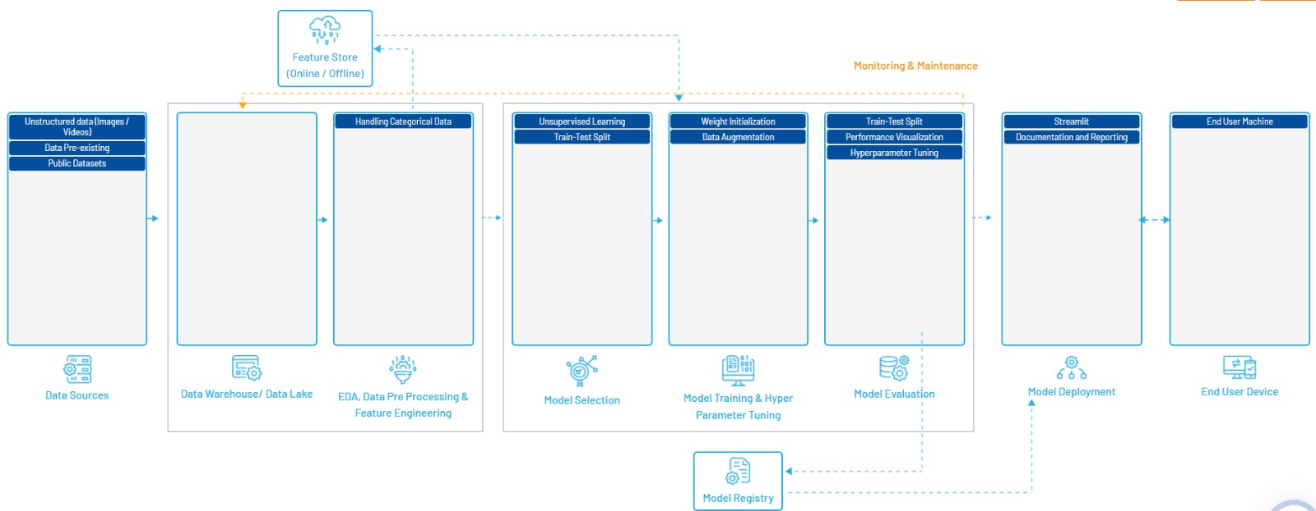
Project architecture

Slide 5
CRISP-ML(Q) Methodology
There are six stages of CRISP-ML(Q) Methodology
1.Business and data understanding
2.Data preparation
3.model building
4.Model evaluation
5.Model deployment
6.Monitoring and maintenance

Slide 6
BUSINESS PROBLEM
Problem
A leading scrap procurer collects metal scraps, which collectively go into a blast furnace ,where the final product would be liquid steel. Lately some hazardous(exploding) materials, including closed containers, are getting into the furnace. These materials are dangerious,disrupting the durability of the furnace, and posing a potential threat to workers.

Slide 7

Business Objective and Constraints
Objective
Constraints
Automate the process and maximize blast furnace safety by detecting hazardous substance,especially closed containers,upfront using ai tools.
Minimize the cost.and improve the standard of the furnace while ensuring the detection system is effective in. identifying closed containers.maximizing safety for workers and the environment

Slide 8
Technical Stacks
Roboflow:Dataset management and augmentation, including labeling, preprocessing, and exporting datasets in various formats suitable for training machine learning models.
2. Google Colab:: Cloud-based platform for running Python code and training machine learning models with free GPU/TPU support. Use Google Colab to train your YOLO models, run experiments, and test models without needing a powerful local machine.
3. Spyder: An Integrated Development Environment (IDE) for scientific programming in Python, offering advanced editing, analysis, and debugging capabilities
4. Streamlit:: A framework for creating interactive web applications for data science and machine learning projects.
5. OpenCV: A powerful library for computer vision tasks, including image processing, video capture, and analysis. Use OpenCV to pre-process your images before feeding them into the YOLO model, or to post-process the output of your model, such as drawing bounding boxes around detected particles.
6. Ultralytics YOLO:A popular object detection framework based on the YOLO (You Only Look Once) architecture, known for its speed and accuracy. Train and deploy object detection models to identify and measure coke particles on a blast furnace belt. YOLO's integration with Roboflow and Colab makes it convenient for quick experimentation.

Slide 9
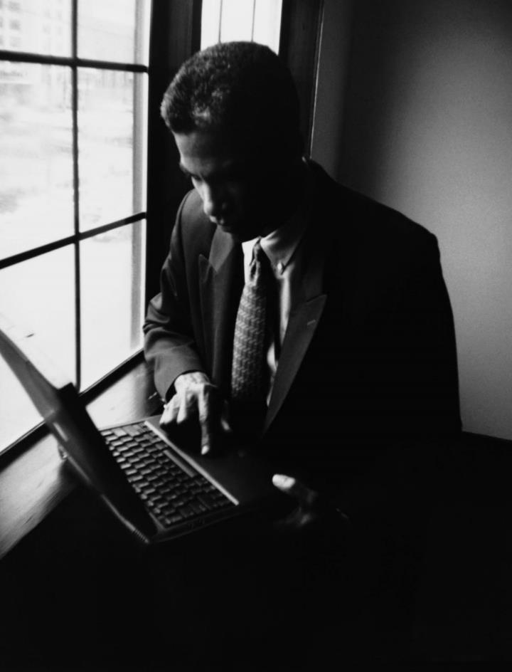
System Requirements
Hardware:
Standard desktop or laptop with sufficient RAM and CPU capacity to handle video processing and machine learning tasks.
Software:
Python environment, including the latest version of Python installed.
Required libraries such as Streamlit, OpenCV, Ultralytics YOLO, etc.
Web browser for accessing the Streamlit application.
Dependencies:
Ensure installation of necessary Python libraries using pip or conda package managers.
Additional Considerations:
Adequate storage space to store videos and processed data.
Continuous monitoring of the system for any errors or issues.
Regular updates of libraries and dependencies for smooth operation and security purposes

Slide 10
Data information
Total Images: Approximately 904 images obtained by combining all images.
Data Content: Each image contains bounding boxes for different object like cylinder, motors, canister, fire-extinguisher, drums detection.
Annotation Details: Bounding boxes annotated manually by using tools polygon from Roboflow, categorized into 6 to 7 different classes.
Data Augmentation: Techniques applied for diversity, including flipping, rotation, scaling etc.
Data Balance: Ensured balance between classes to prevent bias.
Quality Assurance: Regular checks for annotation accuracy and quality.

Slide 11

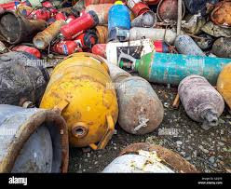
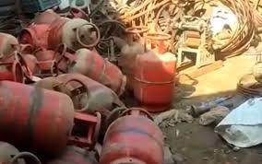
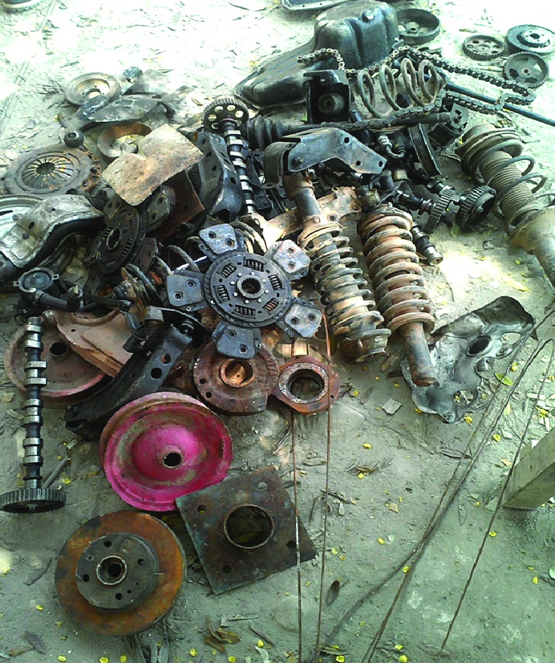
Data Collection and Understanding
DESIGN

Slide 12
Data Collection
Collected different types of hazardous metal scrap images in google and image search app.
More than 350 images of different categories from hazardous metal scrap.
Data Understanding
The collected images contain the hazardous substances like cylinders,cansteres,fire extinguisher,cans,capacitors,shoch absorber
Totally made the 6 to 7 categories

Slide 13
Data preprocessing
Image Frame Cropping:
Unwanted text and irrelevant portions in the image frames were cropped to focus only on relevant content.
Data Annotation with Roboflow:
Utilized Roboflow for annotating the data, categorizing objects into two classes: human and machine.
Data Augmentation:
Data augmentation techniques were applied within Roboflow to enhance the diversity and quality of the training dataset.
Resizing and Data Balancing:
Resized the image frames to a standard size and balanced the dataset by adjusting colors and other attributes to ensure uniformity in the training data distribution.

Slide 14
Model building
Dataset Split:
Training Set: Used for model training, comprising the majority of the data.
Validation Set: Utilized for fine-tuning model parameters and preventing overfitting.
Test Set: Employed to evaluate model performance on unseen data, aiding generalization assessment.
Management:
Organized dataset for efficient training, split into train, validation, and test sets for robust model evaluation.

Slide 15
Model training
Utilized Roboflow for preprocess data and training the model in Google Colab.
Employed YOLOv8 architecture with pre-trained weights (yolov8n.pt) for 100 epochs and a batch size of 16.
Configured YOLOv8 with parameters such as image size (imgsz=640) and epochs (epochs=100).

Slide 16
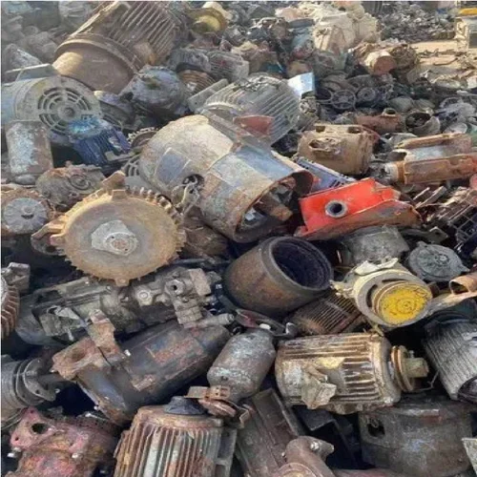
Model deployment
Utilized Streamlit framework for deploying the model and creating a user interface.
Implemented logic to browse and upload videos and images from the local device through the Streamlit app interface.
Upon video and image upload, performed real-time inference to detect hazardous object using the deployed model.

Slide 17
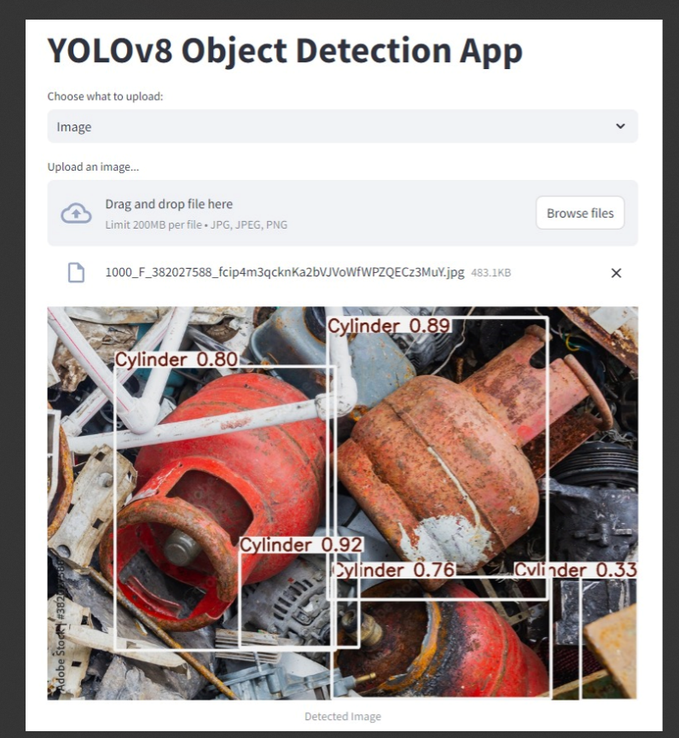
Out put of deployment

Slide 18
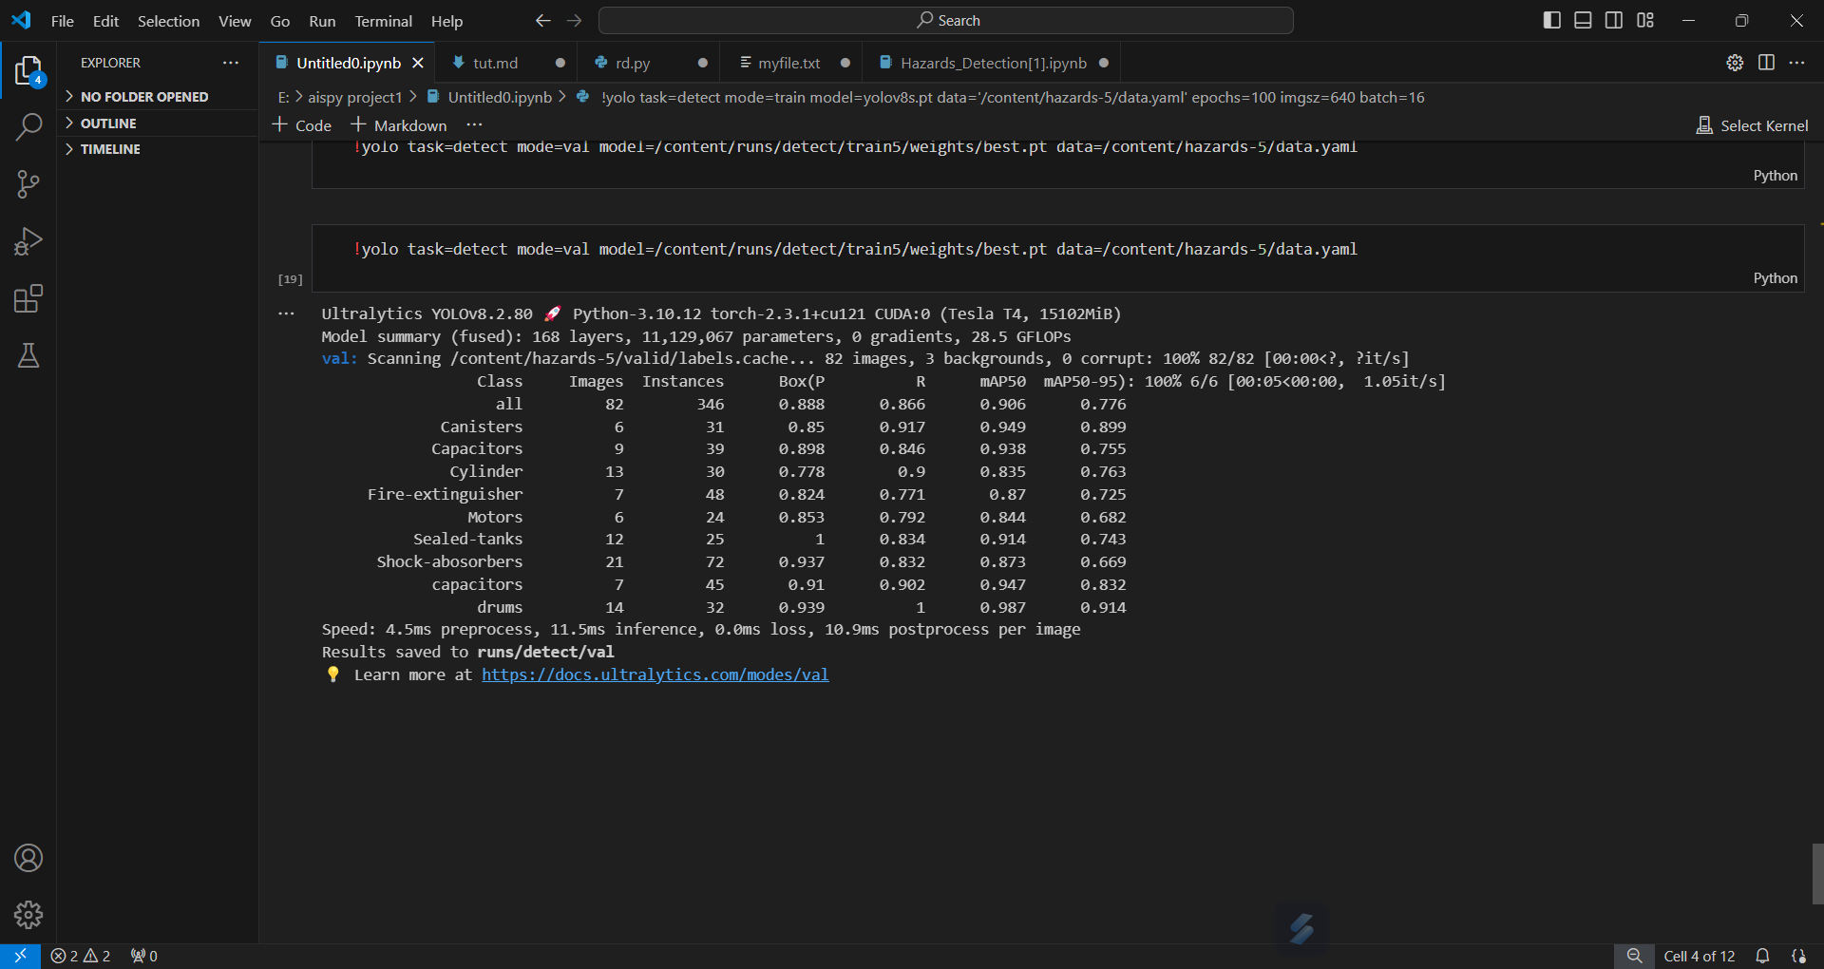
Model evaluation
Utilized confusion matrix, precision, recall, and mean Average Precision (mAP) for model evaluation.
Confusion matrix provides insights into true positives, false positives, true negatives, and false negatives.
Precision measures the proportion of true positive predictions out of all positive predictions.
Recall calculates the proportion of true positive predictions out of all actual positive instances.
Mean Average Precision (mAP) represents the average of precision values at different recall levels.
Evaluation Results:
Precision: 0.88
Recall: 0.86
mAP50: 0.90

Slide 19
Challenges
Data quality: ensuring accurate and well-annotated data for training the model across different environment conditions, lighting, and viewpoints
Realtime interference: implementing algorithms and hardware configurations to enable prompt detection of machine motion in live video streams.
Scalability:desining the system to scale efficiently to accommodate the needs of large poultry farm operations .including monitoring multiple units and extensive areas.
Cost management: addressing the costs associated with hardware software and maintenance to ensure the solution remains economically feasible for both small and medium-sized farms.

Slide 20
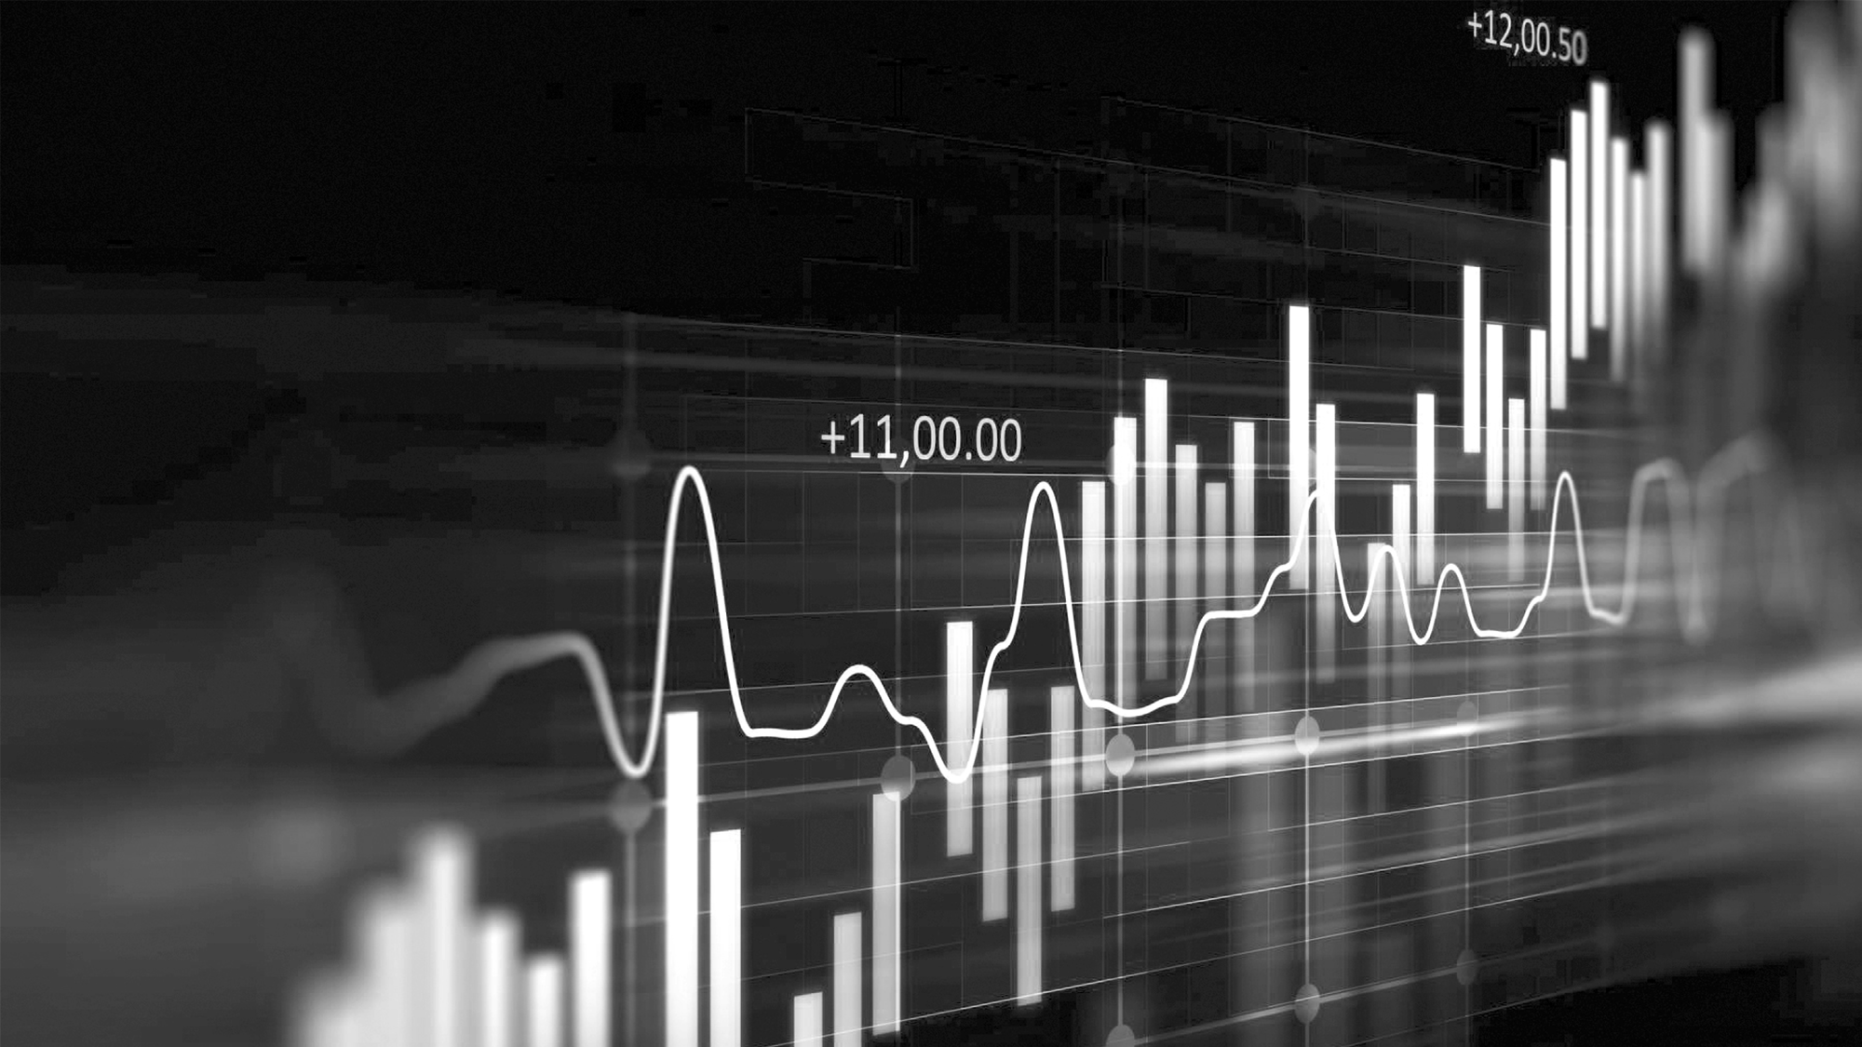
Data sData split Information Da3Information
Future scope
Enhanced Model Architectures
Deep learning models like CNNs, R-CNNs, YOLO, and SSD have already made substantial progress. Future architectures could include more sophisticated variants, such as Vision Transformers (ViT), which use attention mechanisms to improve detection accuracy and handle complex scenes.
It the environmental friendly.and using this technology its not harmful to the workers.
Deep learning will continue to be a driving force behind the evolution of object detection, enabling more advanced, accurate, and context-aware systems across various industries and applications.

Slide 21
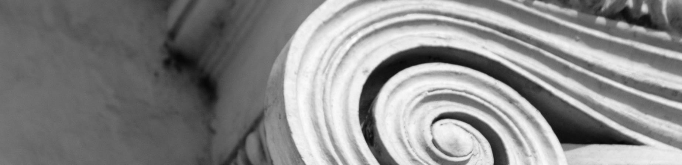
Thank you

